Slide 1
SIT105 – Thinking Technology and Design Class 04
General, Vague & Ambiguous Statements
Dr. Frank Jiang
Frank.Jiang@deakin.edu.au

Slide 2
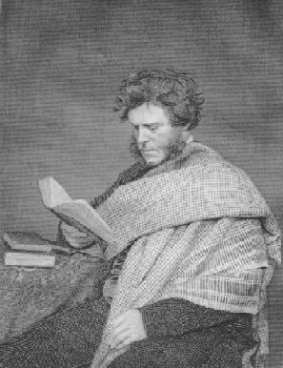
Critical Thinking Quote of the Week
Hugh Miller (1802–1856) was a self-taught Scottish geologist and author/writer and folklorist.
“Problems are only opportunities with thorns on them.”
Problems although challenging are chances to develop new skills and abilities.

Slide 3
So this class let’s look at General, Vague and Ambiguous statements.
This week’s ULO – [1] Apply critical thinking techniques and IT discourse to identify and analyse problems from technical and non-technical perspectives.

Slide 4
Research: Scientists Create Artificial Neural Networks That Detect Human Ambiguity
An international scientific team, which includes scientists from Russia’s Saratov State Technical University, has created an artificial neural network that detects human ambiguity.
In this research, the scientists showed the efficiency of application of the ANN for categorizing human MEG trials corresponding to the sensitivity of bistable visual stimuli with different degrees of ambiguity.
"In this way, we were able to recognize and characterize the state of uncertainty of human choice in detail at the time the decision was made by the brain," Neurotechnology Professor Alexander Khramov said.
This data will help scientists create artificial intelligence (AI) which, in a complex situation will pause before making a decision. It will allow the AI to enter the waiting mode and accumulate information.
This can also be effective for testing and training the cognitive abilities of a person, his ability to make quick decisions in stressful situations. This is vital for many professions such as pilots, drivers, rescuers, military personnel or athletes.
News: https://sputniknews.com/society/201803251062882882-scientists-neural-networks-human-ambiguity/
Journal: https://aip.scitation.org/doi/pdf/10.1063/1.5002892

Slide 5
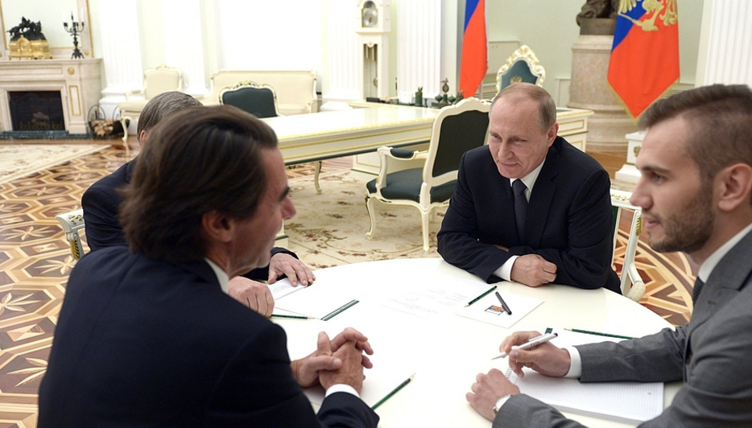
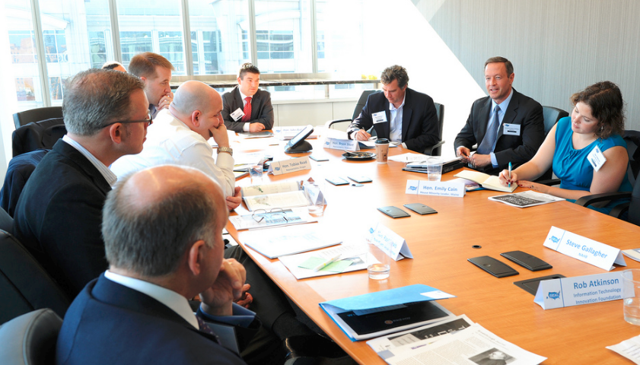
Why?
As critical thinkers realize the importance of language!
It is the foundation of our communication, so we need look closely to how it is being used.
We can run into problems when information is missing that is essential for determining the truth of the claim.
The careless use of language and the different meanings the same word can have.
Also the suggestion of words that irrationally influence readers and that leads to unclear communication.
Lastly, when there is no specific meaning or the meaning is unclear.

Slide 6

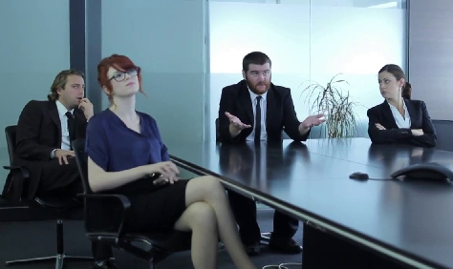


Critical Thinking & IT Projects
Imagine you are in your first client meeting, like the scenario in assessment task 1.
What are some aspects that can cloud our view or judgement on client requirements for example? (which may end up with producing a solution which is not what they want)
Ultimately:
Ambiguity
Vagueness
Generality
Fallacies
We will look at these today!

Slide 7
Why IT Project’s Fail
…Case Studies

Slide 8
Why IT Projects Really Fail!
The Queensland Department of Health payroll project, which ended in debacle with costs estimated at $1.2 billion.
In the US, the Expeditionary Combat Support System project was cancelled after the US Air Force spent $1bn on its development.
Based on industry norms, less than 50% of IT projects finish on time and on budget!
Requirements Analysis Is One Of The Big Reasons! Why?
“Many large projects fail because what they are trying to achieve isn’t made clear enough. There is no clear problem definition or clarity about the requirements, and the full scope of the project is not understood. One executive has an objective, but as the project moves forward new people, such as other executives, risk managers, and architects are introduced, adding their ideas of what would be best. The net result is unclear goals, expanding project scope and poor project design, all of which lead to unending debates and sliding timelines.”
Source: http://www.cio.com.au/article/533532/why_it_projects_really_fail/

Slide 9

Case Study: QLD claims payroll project too complex for IBM
A former senior Queensland bureaucrat said IBM had underestimated the complexity and the resources required to deliver the health payroll system before it went live in 2010.
"There was a belief in government, IBM had not understood the complexity of the Queensland Health payroll system. And they had not put enough resources – the numbers and calibre of people – that was required," Mr Grierson told the Supreme Court in Brisbane on Wednesday.
Source: http://www.afr.com/news/politics/qld-claims-payroll-project-too-complex-for-ibm-20150826-gj7vdp
Question:
What reason might exist for misunderstanding the complexity and resources requirements?
What could have been done differently?

Slide 10

Case Study: National Broadband Network
A leaked internal document revealing that the NBN's rollout of fibre-to-the-node has been well behind schedule is further confirmation that Malcolm Turnbull's version of the NBN is proving to be much more expensive to deliver than was originally hoped.
The network has blown out twice in projected cost - first, from $29.5 billion to $41 billion, and then last year to "up to" $56 billion. And instead of delivering 25 Mbps by 2016, now the network isn't expected to be finished until 2020
Some issues discovered with relation to not understanding requirements with this project are:
Bad advice on the design of the network in terms of best technology (copper wire integration)
Trouble negotiating a one-off deal with Telstra to use copper wires
Lack of any market discipline: there was no attempt to target those areas that were readiest to pay for fast broadband
The NBN's computers had to be upgraded to cope with the extra complexity of integrating the new mix of connection technologies
http://www.abc.net.au/news/2016-03-01/manning-what-went-wrong-with-the-nbn/7210408

Slide 11
Clarifying your Language!

Slide 12
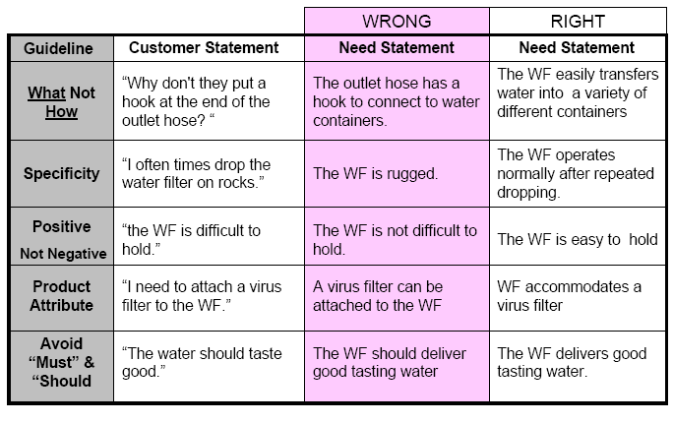

Customer Needs Statement Example – Water Filter Bottle
REVISION
Ulrich and Eppinger
Notes:
Groups to focus their Needs Analysis on the customers who would use their solution.

Slide 13
Quality and Test Plan for your Requirements
Validate Requirements; inspect for common defects and able to answer yes to the following questions:
Is each requirement abstract?
Is each requirement unambiguous?
Is each requirement verifiable?
Is each requirement traceable to a user need?
Is each requirement realistic and technically feasible? may be hard to determine. Handy to compare benchmarks or system prototypes.
Develop a Verification Plan (test) for each requirement

Slide 14

Language Can Be Difficult to Understand
Vagueness, Ambiguity and Generality can make an language difficult to understand!
This can lead to failed projects or just making them more difficult than they need to be!
Determining things like requirements in projects is especially hard because language is not a precise science
People/culture can also cause difficulties in formulating valid claims and arguments
Language itself is vague!
In contrast, computers, are precise machines!

Slide 15

Vagueness
A sentence, phrase or word is vague when it has no specific meaning or the meaning is unclear.
If requirements are clear, IT solutions are possible!
Examples:
At what temperature is water hot? Where is the borderline separating cold from hot?
What about these words: Loud, Dark, Fast, Heavy, Cloudy, Windy, Sticky, Wet, Selfish, Depressed, Sick, Sleepy, ...

Slide 16
Ambiguity
A sentence, phrase or word is ambiguous when it has more than one meaning or interpretation.
Why are each of the following ambiguous?
John is renting a house. (either owns it or is renting it).
You will need a birth certificate or a driver’s license and another photo ID.
Donald McRonald is a doctor (what kind of doctor?).

Slide 17
Fallacies
Quick Fact!
A fallacy is:
something deceptive or misleading,
when you believe something is true, but it’s false.
A fallacy is a kind of error in reasoning or thinking.
Fallacies should not be persuasive, but often they can be quite persuasive.
Fallacies can be created unintentionally, or they may be created intentionally in order to deceive or betray other people!
The vast majority of the commonly identified fallacies involve arguments, although some involve explanations, or definitions.
Quick Link!
Here is the list of fallacies which contains 213 of the most common fallacies, brief explanations and examples of each of them.
Source: http://www.iep.utm.edu/fallacy/

Slide 18
Another Fallacy Example
Jumping to Conclusions
It is not always a mistake to make a quick decision, but when we draw a conclusion without taking the trouble to acquire enough of the relevant evidence, our reasoning uses the fallacy of jumping to conclusions (provided there was sufficient time to acquire and assess that extra evidence, and provided that the extra effort it takes to get the evidence isn't prohibitive.)
Example:
This car is really cheap. I'll buy it.
Hold on. Before concluding that you should buy it, you ought to have someone check its operating condition, or else you should make sure you get a guarantee about the car's being in working order. And, if you stop to think about it, there may be other factors you should consider before making the purchase, such as size, appearance, and gas usage.
Source: http://www.iep.utm.edu/fallacy/

Slide 19

Generality
Quick Example. ‘Most’ students will go onto University.
The less detail a claim provides, the more general it is!
Generality is a source of vagueness and ambiguity.
Examples
A child can be a small person
A child can be a small and young person
A child can be a girl or boy
Less Detail
More General
More Detail
Less General

Slide 20
Generality (Examples)
The less detail a claim provides, the more general it is!
Sigmund Freud is one of the greatest names in medical history.
General! In this statement, several specific examples could be given to prove why Freud is one of the greatest names in medical history, so this is a General Statement.
Mario Andretti is a successful Race-car driver.
General! This statement about Andretti suggests that there are many specific examples that you could list to prove that he is a successful racer.

Slide 21

Now let’s look at the theme of this class.
Generality, Vagueness and Ambiguity with Regards to Online Shopping!

Slide 22
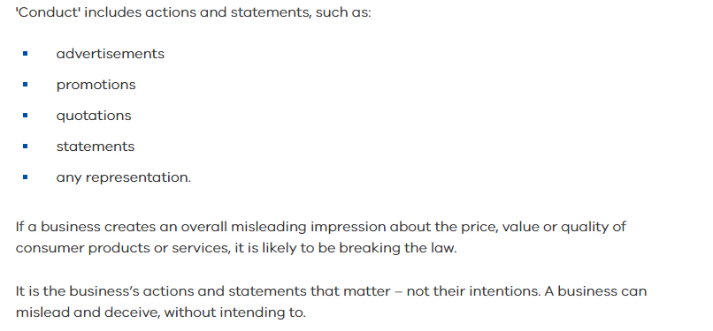
Consumer Affairs: Misleading or Deceptive Conduct

Slide 23
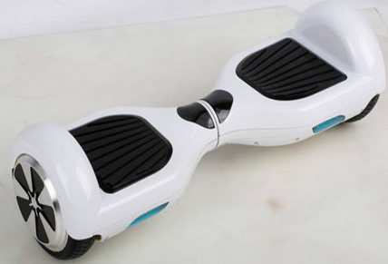
Online Product Description!
Spot the vague, ambiguous, fallacy and general statements!
Our white hover board or 2 wheel self balancing scooters are a fast way to get around.
Designed for everyday use, with quick manoeuvring through any type of terrain! City or urban and regional areas.
Most people will master the hover board in a few hours.
Designed with smart-sensor technology which means that every time you lean forward too much while accelerating, the scooter will automatically trigger it’s sensors to slow down and stop you from falling off.
Price: From $700 to $800 depending on your colour choice.
Blue=Vague
Red=Ambiguity
Green=Generality
Orange=Fallacy

Slide 24
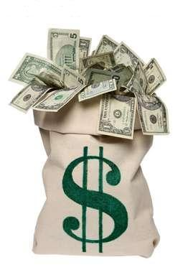
Case Study: Online Shopping
There are plenty of stories of people buying expensive items through sites like eBay or Gumtree and the product doesn't turn up, at all !
This news article talks about one person who was really excited about finding a motorbike on eBay for a great price ($10,000). However, when the motorbike didn't turn up, they struggled to get any assistance from the online website, police or other legal avenues.
The author then asked the readers of The Morning Bulletin, for their pros and cons of online shopping:
Pros to Online Shopping:
Better choice - more variety of colours, sizes, etc.
Cheaper prices - many say they find prices are 1/2 to 1/3 of price being charged in shops
Cons to Online Shopping:
Items may not be as described
Items may be broken or lost in the post
Source: http://www.themorningbulletin.com.au/news/pros-and-cons-online-shopping-and-selling-goods/2080166/

Slide 25
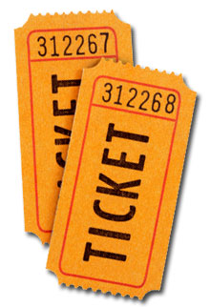
News: Online ticket sellers ‘getting away’ with vague prices and seating rules
You might think you've found the last ticket to your favourite gig, but without knowing important information, it could be worthless!
Loyal One Direction fans are being led in the wrong direction by re-sale websites which are flouting the law and not displaying ticket face values.
An investigation by consumer watchdog Which? found five of the country’s most popular sites fell short of coming clean with all the information required by the new Consumer Rights Act.
For example 1D fans desperate to get their hands on concert tickets found Viagogo’s vague face value of £44.55 to £72.60 unhelpful as they had no idea how much over the odds they were paying.
Booking fees are especially frustrating as all too often you think you're getting a good deal and then you get to the final stage of an online booking form and find you have to pay more.
Source: http://www.mirror.co.uk/money/online-ticket-sellers-getting-away-6675390

Slide 26
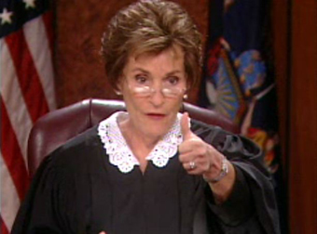
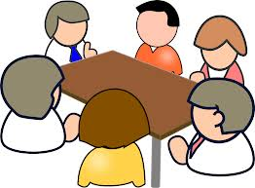
Judge and Jury!
Question!
Is it up to the buyer to be more careful (e.g. assessing vagueness) with what they are buying or purely the sellers responsibility?
Join together with other students near you.
Discuss your answers with each other for 5 minutes.
Share your responses and with the entire class: everyone else is free to challenge for or against those ideas.

Slide 27
In Conclusion…
A sentence, phrase or word is vague when its meaning is unclear.
A sentence, phrase or word is ambiguous when it has more than one meaning.
A fallacy is something deceptive or misleading.
The less detail a claim provides, the more general it is!
Online shopping is a problematic area which is riddled with problems related to these topics.
Be careful when purchasing online – analyse your product options carefully !

Slide 28


Take 5
From today’s class and our group discussions.
Take 5 minutes to jot down the main things you learned today…. What are your ‘takeaways’.

